Slide 1
Introduction to Database

Slide 2
Background
Computer initially used for computational / engineering purposes
Commercial applications introduced File Processing System

Slide 3
File Processing System
A file processing system is a method of managing and organizing data within a computer system using files
In a file processing system, data is stored in individual files, and programs are designed to read, write, update, and manipulate these files directly
A collection of application programs that perform services for the end-users such as production of reports
Each program defines and manages its own data

Slide 4
File Processing System
Library
Examination
Registration
Library
Applications
Examination
Applications
Registration
Applications
Library
Data
Files
Examination
Data
Files
Registration
Data
Files

Slide 5
File Processing System
Library
Examination
Registration
Reg_Number
Reg_Number
Reg_Number
Name
Name
Name
Father Name
Address
Father Name
Books Issued
Class
Phone
Fine
Semester
Address
Grade
Class

Slide 6
Limitations
Separation and Isolation of Data
Each program maintains its own set of data
Users of one program may be unaware of potentially useful data held by other programs
Duplication of data
Decentralized approach taken by each department
Same data is held by different programs
Wasted space and potentially different values and/or different formats
storage for the same item

Slide 7
Limitations
Limited Data Sharing
No centralized control of data
Programs are written in different languages, and so cannot easily access each other’s files.
Program-Data Dependence
File structure is defined in the program code
All programs maintain metadata for each file they use

Slide 8
Problems with Data Dependency
Each application programmer must maintain their own data
Each application program needs to include code for the metadata of each file
Each application program must have its own processing routines for reading, inserting, updating and deleting data
Lack of coordination and central control
Non-standard file formats

Slide 9
Problems with Data Redundancy
Waste of space to have duplicate data
Causes more maintenance headaches
The biggest problem:
When data changes in one file, could cause inconsistencies (Vulnerable to Inconsistency and inefficiency)
Compromises data integrity (data reliability)

Slide 10
Solution – Database Approach
Central repository of shared data
Data is managed by a controlling agent
Stored in a standardized, convenient form

Slide 11
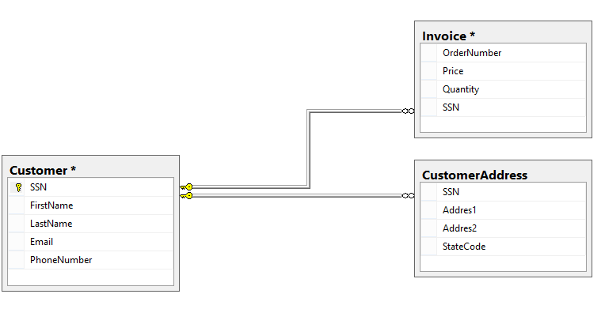
Database

Slide 12

Advantages of Database Approach
Library
Examination
Registration
Library
Applications
Examination
Applications
Registration
Applications
Database
Management
System
- Data Sharing
- Data Independence
University
Students
Database
- Controlled Redundancy
- Better Data Integrity

Slide 13
Database Management System – DBMS
A software system that enables users to define, create, maintain, and control access to the database

Slide 14
Database
Shared structured collection of logically related data, along with description of this data, designed to meet the information needs of an organization
Metadata provides description of data to enable program data independence

Slide 15
SQL
SQL stands for Structured Query Language. It is used for storing and managing data in a database.
It enables a user to create, read, update and delete relational databases and tables.
SQL allows users to query the database in a number of ways, using English-like statements.

Slide 16
What Can SQL do?
SQL can execute queries against a database
SQL can retrieve data from a database
SQL can insert records in a database
SQL can update records in a database
SQL can delete records from a database
SQL can create new databases
SQL can create new tables in a database
SQL can create stored procedures in a database
SQL can create views in a database
SQL can set permissions on tables, procedures, and views

Slide 17
SQL Commands
SELECT - extracts data from a database
UPDATE - updates data in a database
DELETE - deletes data from a database
INSERT INTO - inserts new data into a database
CREATE DATABASE - creates a new database
ALTER DATABASE - modifies a database
CREATE TABLE - creates a new table
ALTER TABLE - modifies a table
DROP TABLE - deletes a table
CREATE INDEX - creates an index (search key)
DROP INDEX - deletes an index

Slide 18
SQL Queries
Suppose we have a Customer Table.
CustomerID | CustomerName | Address | City
1 | Ali | ABC Street | Lahore
2 | Ahmed | XYZ Street | Karachi
3 | Bisma | GHI Lane | Multan
4 | Faraz | RTY Road | Islamabad

Slide 19
SQL Queries- Select
Write a query to show all entries of the table
SELECT * FROM Customers;
Output:
CustomerID | CustomerName | Address | City
1 | Ali | ABC Street | Lahore
2 | Ahmed | XYZ Street | Karachi
3 | Bisma | GHI Lane | Multan
4 | Faraz | RTY Road | Islamabad

Slide 20
SQL Queries - Select
Write a query to display customer name and city from the table
SELECT CustomerName, City FROM Customers;
Output:
CustomerName | City
Ali | Lahore
Ahmed | Karachi
Bisma | Multan
Faraz | Islamabad

Slide 21
SQL Queries - Select
Write a query to display all customers from Multan city
SELECT * FROM Customers
WHERE City=‘Multan';
Output:
CustomerID | CustomerName | Address | City
3 | Bisma | GHI Lane | Multan

Slide 22
SQL Queries - Insert
INSERT INTO Customers (CustomerName, Address, City) VALUES (‘Shehzad’, ‘lane345 street 6’, ‘Multan’);

Slide 23
SQL Queries - Insert
INSERT INTO Customers (CustomerName, Address, City) VALUES (‘Shehzad’, ‘lane345 street 6’, ‘Multan’),
VALUES (‘Ahsan’, ‘House no 45 street 9’, ‘Karachi’);

Slide 24
SQL Queries - Delete
DELETE FROM table_name WHERE condition;
Example:
DELETE FROM Customers WHERE CustomerName= ‘Ahsan';
DELETE FROM Customers; (deletes all rows)
DROP TABLE Customers; (delete the table completely)

Slide 25
SQL Queries - Update
UPDATE table_name SET column1 = value1, column2 = value2, ... WHERE condition;
Basic operations queries in database are known as:
CRUD ( Create, Read, Update, Delete )
Example:
UPDATE Customers SET CustomerName = Ahmed Ali', City= ’Islamabad' WHERE CustomerID = 2;

Slide 26
Information System

Slide 27
Information System – Definition
The Information system can be defined as a collection of software, hardware, and telecommunications network that people develop and use to gather, create, and distribute useful data, mainly in organizational settings.

Slide 28
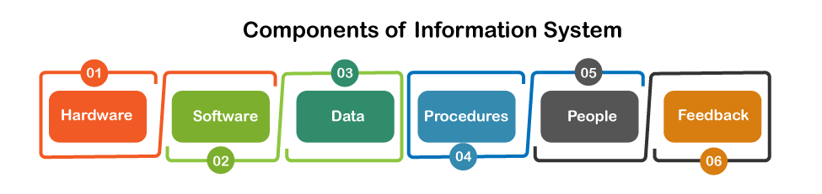
Information System Components

Slide 29
Information System Components
Hardware – includes equipment and machinery and encompasses the computer and all of its supporting equipment
Software – computer programs as well as the manuals which support them

Slide 30
Information System Components
Data – facts that systems use to generate valuable knowledge
Procedures – rules which govern how an operation is performed in information system

Slide 31
Information System Components
People – every system requires individuals if the system is to be beneficial. They have the greatest impact on the success or failure of information systems
Feedback – determines that an information system can be offered with feedback

Slide 32
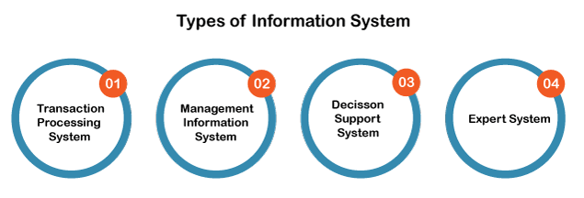
Types of Information Systems

Slide 33
Transaction Processing System
Refers to an information system that processes data originating from business transactions
Designed to process routine transactions efficiently and accurately
Managers often use these systems to deal with such tasks as payroll, customer billing and payments to suppliers
Examples are Stock control systems, Payroll systems, Bill systems

Slide 34
Management Information System (MIS)
Refers to a computer based system that provides managers with the tools to organize, evaluate and efficiently manage departments within an organization
Purpose is to transform comparatively raw data accessible through using TPS (Transaction Processing System) into a summarized and aggregated form for managers, generally in the form of a report
Examples are Human Resource Management System and Sales Management Systems

Slide 35
MIS – Uses
Computer Hardware and Software
Manual Procedures
Models for analysis, planning, control and decision making, and
A database
Store and organize vast amounts of organizational data for easy retrieval
Support data analysis, trend identification, and forecasting to aid in strategic decision-making
Automate routine and repetitive tasks, reducing manual workload and minimizing errors
Improve customer service by providing a comprehensive view of customer interactions and preferences.

Slide 36
Need for MIS
Manager makes decisions all the time.
There is an overload of information and not all information is not useful.
Anything which helps manager improve his decision-making will lead to better result.
MIS is a system, where data is the input, which is processed to provide output in the form of information reports, summaries, etc. which aid the manager’s decision-making process.

Slide 37
Benefits of MIS
Improve Planning and Control - MIS improves the quality of plans by providing relevant information for decision – making. It serves as a link between managerial planning and control
Minimize Information Overload - MIS change the larger amount of data into summarized form and therefore, avoids the confusion which may arise when managers are flooded with detailed facts
Encourages Decentralization – decentralization of authority is possible when there is a system for monitoring operations at lower levels
Brings Coordination – MIS facilitates integration of specialized activities by keeping each department aware of the problem and requirements of other departments. It connects all decision centers in the organization

Slide 38
Decision Support System
Specifically designed to help management make decisions in situations where there is uncertainty about the possible outcomes of those decisions
Includes tools and techniques to help gather relevant information and examine other options, and substitutes, fostering a more intricate involvement for end-users in the decision-making process, as opposed to in MIS
Examples are Bank loan management systems, Financial planning systems

Slide 39
Executive Information System / Expert System
Designed to help senior management make strategic decisions
ESS typically involve lots of data analysis and modeling tools to help strategic decision-making
The principles of artificial intelligence research are used to develop these kinds of information systems.
Examples include CaDet(Cancer Detection Support Tool), etc.

